Slide 1













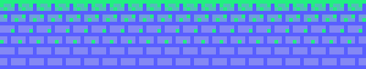
PLAYER 1
HIGHSCORE 2500
PLAYER 2
ARCADEMANIA
Add a short description

Slide 2







01
07
12
AGENDA
Various games can be played on the website Arcade Mania.
Player need or need not have to signup he can be a guest too, cool right?.
The player can mark his favorite games, making it simpler to replay them.
You want to compete? well there's leaderboard too.
Have fun playing!

Slide 3
MEET THE TEAM MEMEBERS
RICHA JAIN
SHREYA SISODIYA
RIDDHI VORA
MUSKAN SRIVASTAVA
KRISHNNA SARRDAH

Slide 4









TECH STACK

Slide 5
GAMES
2048
MINE SWEEPER
CAR CRASH
SNAKE GAME
TIC TAC TOE
ROCK PAPER SISSOR
BET CARD
MEMORY GAME

Slide 6
FEATURES & MODULES
1 | AUTHENTICATION
SIGN UP & SIGN IN
GOOGLE SIGN IN
4| FAVORITES &
Recently Played
SET/UNSET GAME FAVORITE
LAST PLAYED GAME BY USER
5 | USER PREFERENCES
ÜSUPPORT THEME PERSONALIZATION
2 | LEADERBOARD
TOP SCORES FOR EACH GAME
6| DASHBOARD
INTERACTIVE GAME DASHBOARD
3 | USER PROFILE
CUSTOMIZE USER PROFILE

Slide 7

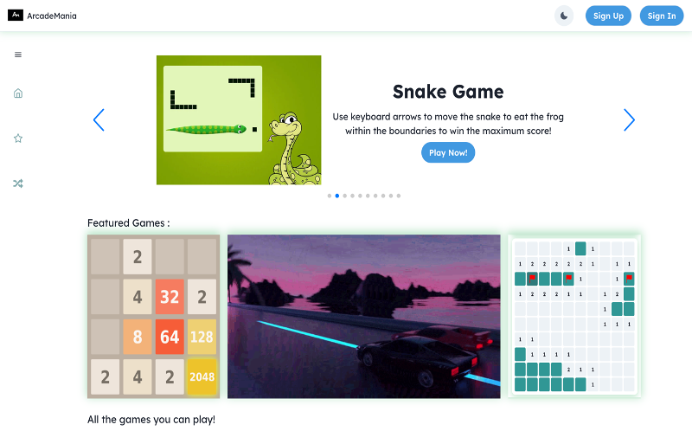
WHITEBOARD PAGE DESKTOP VIEW

Slide 8

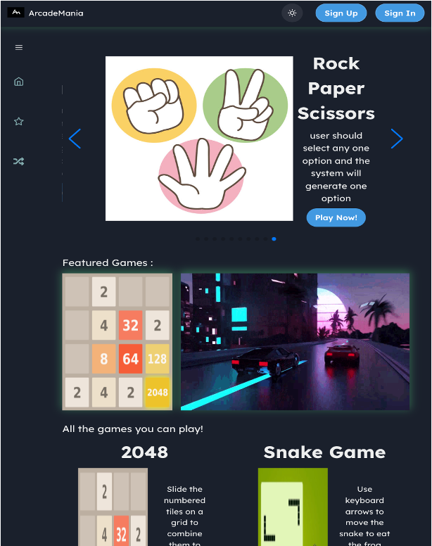
TAB VIEW

Slide 9
REFERENCES
CHAKRA UI : HTTPS://NEXTJS.ORG/DOCS/GETTING-STARTED
JAVASCRIPT GAME IDEAS : HTTPS://WWW.WEBTIPS.DEV/JAVASCRIPT-GAME-IDEAS
SASS DOCS : HTTPS://SASS-LANG.COM/DOCUMENTATION
PASSPORTJS DOCS : HTTPS://WWW.PASSPORTJS.ORG/DOCS
REACT & REDUX : HTTPS://REACTJS.ORG/DOCS

Slide 10
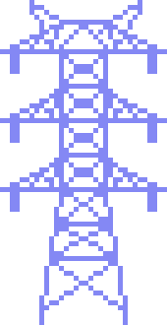


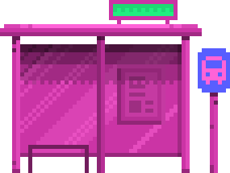




THANK YOU!

